Slide 1
The Sleep Insights

Slide 2
introduction
The Sleep Insights
The Sleep Insights explains how sleep, stress, age, and work are connected. The study shows that people who sleep enough hours usually have better sleep quality. High stress makes sleep worse. People with sleep problems like insomnia or sleep apnea do not sleep well. Stress levels are different for different jobs, and stressful jobs affect sleep more. Overall, the study shows that good sleep habits and stress control are important for a healthy life.

Slide 3

Key findings
This section shows the overall average values from the dataset.
Average Sleep Duration: 7.23 hours > On average, people sleep a little more than 7 hours per day, which is close to a healthy sleep range.
Average Quality of Sleep: 7.66 (out of 10) > This means most people rate their sleep quality as good.
Average Stress Level: 4.68 (out of 10) > Stress levels are moderate to low, showing that overall stress is manageable.

Slide 4
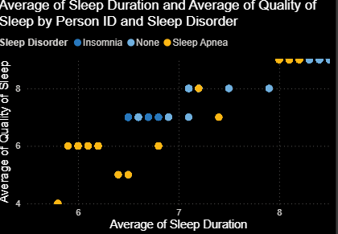
“sleep duration v/s quality”
This graph shows the relationship between Average Sleep Duration (X-axis) and Average Quality of Sleep (Y-axis) for different people, grouped by Sleep Disorder type.
1. Overall Pattern
There is a positive relationship between sleep duration and sleep quality.
> As sleep hours increase, sleep quality also improves.
2. People with No Sleep Disorder
Mostly seen in the higher range of the graph.
Sleep duration: 7–8+ hours, Sleep quality: 7–9
> These individuals have good sleep habits and better sleep quality.
3. People with Insomnia
Generally appear in the lower and middle ranges.
Sleep duration: 6–7 hours , Sleep quality: 5–7
> Insomnia leads to shorter sleep and poorer sleep quality.
4. People with Sleep Apnea
Found in the middle range of the graph.
Sleep duration: 6.5–7.5 hours , Sleep quality: 6–8
> Even with reasonable sleep hours, sleep quality is reduced due to breathing problems during sleep.
5. Graph conclusion
Longer sleep duration is associated with better sleep quality, People without sleep disorders show the best sleep outcomes
Sleep disorders negatively affect sleep quality

Slide 5
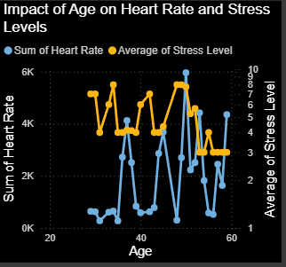
Age on heart rate v/s stress level
This graph shows how age affects heart rate and stress levels.
X-axis: Age
Left Y-axis (Blue line): Heart Rate , Right Y-axis (Yellow line): Average Stress Level
Key Observations
Stress levels (yellow line):
>Higher during young to middle age
>Gradually decrease at older ages
>Indicates that stress reduces as age increases
Heart rate (blue line):
>Fluctuates a lot across different ages
>Peaks in some middle-age groups
>No smooth trend, showing heart rate varies from person to person
Graph conclusion
> Age has a clear impact on stress levels
>Younger and middle-aged individuals experience higher stress
>Heart rate varies with age but does not follow a consistent pattern
>Stress levels tend to decrease with age, while heart rate shows irregular changes across different age groups.

Slide 6
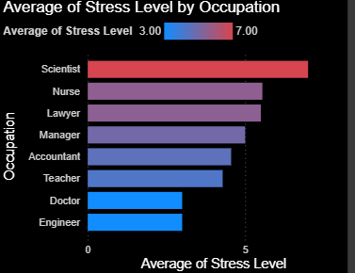
Stress level by occupation
This chart shows the average stress level for different occupations.
>X-axis: Average Stress Level , Y-axis: Occupation
Key Observations
>Scientists have the highest stress level
>Nurses and Lawyers also show high stress
>Managers and Accountants have moderate stress
>Teachers experience lower stress
>Doctors and Engineers have the lowest stress levels
Graph conclusion
>Stress levels vary significantly across professions
>Jobs with high responsibility and pressure tend to have higher stress
>Technical and structured roles show comparatively lower stress
>Stress is highest in research and healthcare-related roles and lowest in technical and engineering professions.

Slide 7
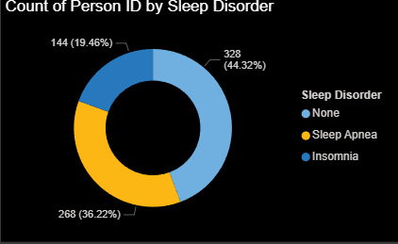
Count of person v/s sleep disorder
This donut chart shows the number of people in each sleep disorder category.
No Sleep Disorder: 328 people (44.32%)
Sleep Apnea: 268 people (36.22%)
Insomnia: 144 people (19.46%)
Key Observations
>The largest group has no sleep disorder
>A significant number of people suffer from sleep apnea
>Insomnia affects a smaller but still important portion of the population
graph Conclusion
>More than half of the population experiences some form of sleep disorder
>Sleep-related health issues are common and widespread
>While most people do not have sleep disorders, a large proportion still suffers from sleep apnea or insomnia

Slide 8
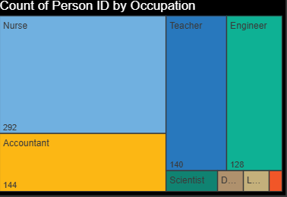
Count of person V/S occupation
This tree map shows the number of people in each occupation in the dataset.
>Nurses form the largest group with 292 people
>Accountants are the second largest group (144 people)
>Teachers also have a high count (140 people)
>Engineers are moderately represented (128 people)
>Scientists, Doctors, and Lawyers have smaller counts
Key Observations
>The dataset contains more participants from healthcare and education fields
>Some occupations are less represented, which may affect comparisons
Graph conclusion
>Occupation distribution is not equal
>Results are influenced more by professions with higher participant counts
>Nurses and accountants make up the largest share of the dataset, while other occupations have fewer participants.

Slide 9
Recommendations & Conclusion
Recommendations
Encourage 7–8 hours of sleep daily to improve sleep quality
Promote stress-management techniques (meditation, exercise, breaks), especially for high-stress jobs
Conduct regular sleep disorder screenings for insomnia and sleep apnea
Employers should support work–life balance, especially in healthcare and research roles
Maintain a healthy lifestyle (balanced diet, normal BMI, physical activity) to support better sleep
Increase awareness about the impact of stress on sleep and health
Conclusion
The analysis shows a strong link between sleep duration and sleep quality
Stress levels vary by occupation and affect sleep health
Sleep disorders significantly reduce sleep quality and duration
Age and lifestyle factors influence stress and heart rate
The Power BI dashboard provides valuable insights to improve sleep habits and overall well-being

